Slide 1
Welcome and Introduction ANMitra Memorial Function April 14 and 15, 2026
N.Panchapakesan, University of Delhi
Happy Baisakhi, Happy Tamil New Year,
Remembering Baba Saheb Ambedkar on his Birthday
ANMitra Birthday on April 15.

Slide 2
Recent Deaths
Vaidyeswaran Rajaraman 2.Ramamurthy Rajaraman
3. Aiyalam Parameswaran Balachandran
4. Anthony Legget

Slide 3
Vaidyeswaran Rajaraman 8-9-1933 to 8-11-2025
Legend of Computer Science, Joined IITKanpur in 1961,moved to IISc B’ngaluru, Wrote 23 inexpensive Best sellerText books, many with wife Dharma
Became a well known name in India and abroad for teaching and research in computer science
My classmate in MEA School and St Stephen’s College both in Delhi

Slide 4
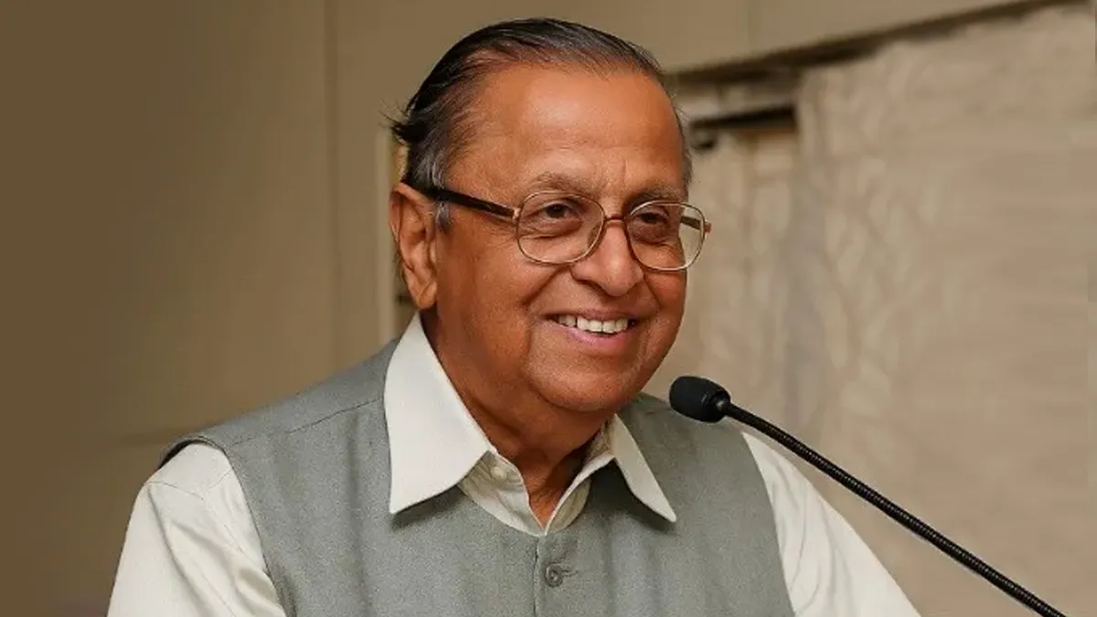

Slide 5
Vaidyeswaran Rajaraman 8-9-1933 to 8-11-2025
Legend of Computer Science, Joined IITKanpur in 1961,moved to IISc B’ngaluru, Wrote 23 inexpensive Best sellerText books, many with wife Dharma
Became a well known name in India and abroad for teaching and research in computer science
My classmate in MEA School and St Stephen’s College both in Delhi

Slide 6
Ramamurthi Rajaraman 11-3-1939 to12-7-2025
Again MEA HS School, St. Stephen’s College, both Delhi
Along with Hans Bethe in 1963 ,at Cornell university
Considered the contribution of Three body and higher number of bodies interaction for his thesis.
Worked in many areas of theoretical physics.
Worked on Nuclear Disarmament and Nuclear energy
ANMitra started studying three body interaction in 1961 .

Slide 7
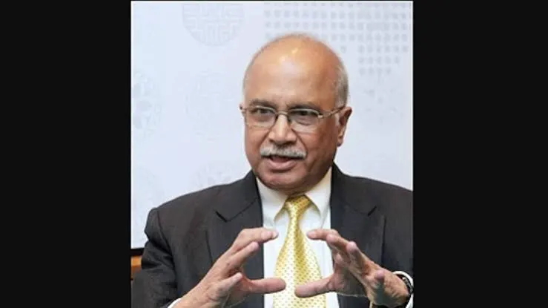

Slide 8
Ramamurthi Rajaraman 11-3-1939 to12-7-2025
Again MEA HS School, St. Stephen’s College, both Delhi
Along with Hans Bethe in 1963 ,at Cornell university
Considered the contribution of Three body and higher number of bodies interaction for his thesis.
Worked in many areas of theoretical physics.
Worked on Nuclear Disarmament and Nuclear energy
ANMitra started studying three body interaction in 1961 .

Slide 9
Aiyalam Parameswaran Balachandran 26-1-1938 to18-4-2025
PhD with Alladi Ramakrishnan at Matscience, Chennai ,Postdoc Univ of Chicago
Well known Mathematical Physicist, with Kamesh Wali, at Syracuse in USA.
His group had studied Skyrmions in 1982s when I visited them.
Witten visited them after that and wrote an article which became famous
Shivaji Sondhi applied it to Q. Hall effect later in1990s after reading R Rajaraman’s book on solitons. Small world.

Slide 10
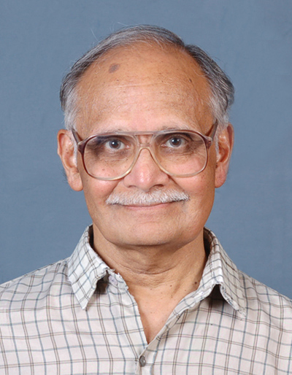

Slide 11
Aiyalam Parameswaran Balachandran 26-1-1938 to18-4-2025
PhD with Alladi Ramakrishnan at Matscience, Chennai ,Postdoc Univ of Chicago
Well known Mathematical Physicist, with Kamesh Wali, at Syracuse in USA.
His group had studied Skyrmions in 1982s when I visited them.
Witten visited them after that and wrote an article which became famous
Shivaji Sondhi applied it to Q. Hall effect later in1990s after reading R Rajaraman’s book on solitons. Small world.

Slide 12
Anthony Leggett 26-3-1938 to 8-3-2026
2003 Nobel prize for work on quantum phase transitions in He3.
Later studied how big can a quantum system be ?
Predicted systems which were created 45 years ago with Josephson’s junctions
The creators got the Nobel prize only last year.
Relation between Classical and Quantum mechanics still not understood fully.

Slide 13
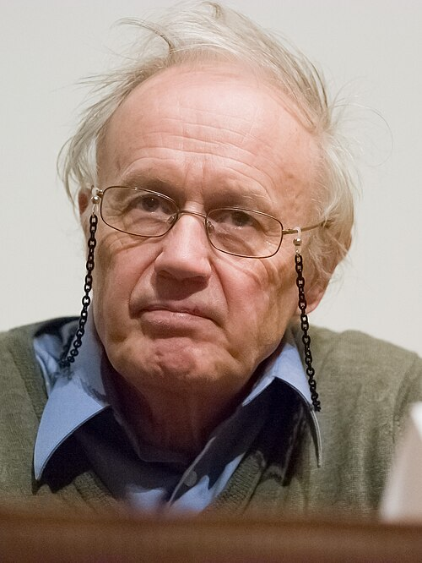
Anthony Leggett

Slide 14
Anthony Leggett 26-3-1938 to 8-3-2026
2003 Nobel prize for work on quantum phase transitions in He3.
Later studied how big can a quantum system be ?
Predicted systems which were created 45 years ago with Josephson’s junctions
The creators got the Nobel prize only last year.
Relation between Classical and Quantum mechanics still not understood fully

Slide 15
Quantum Mechanics to Classical Mechanics
1. Collapse takes one to Cl. Mech. No Unitarity. No Time reversal invariance, in the transition.
2. What if detector is also included in the system ? Can there be an end to enlarging the system. Wigner in 1960 thought it will end in human consciousness. It can be consciousness of Wigner or any other (Wigner’s friend).
3. Zurek in in 1990s suggested Decoherence by Environment, especially Cosmic Microwave Background Radiation. Wigner changed his mind and accepted it in 1990s. Zurek and others have a model in the book Quantum Darwinism. No general acceptance yet.

Slide 16
Gravitation may play a role
1. Roger Penrose thinks so.
2. Black Holes may play a role .
3. Hawking using QM in curved space time discovered emission of thermal radiation. That leads to information loss and violation of unitarity. No agreement on what happens or Why.
4. No wonder Feynmann says “Anyone who says he or she understands QM, does NOT understand it.”
5. The talks in this meeting may discuss this problem

Slide 17
Measurement and Collapse of Wave function takes one to Decoherence and Classical Mechanics Bohr’s Copenhagen interpretation

Slide 18
Interpretation of Quantum Mechanics
Going beyond Copenhagen interpretation seems necessary.

Slide 19
Thank You
Enjoy the Talks

Slide 20
Thank You

